Slide 1


Slide 2
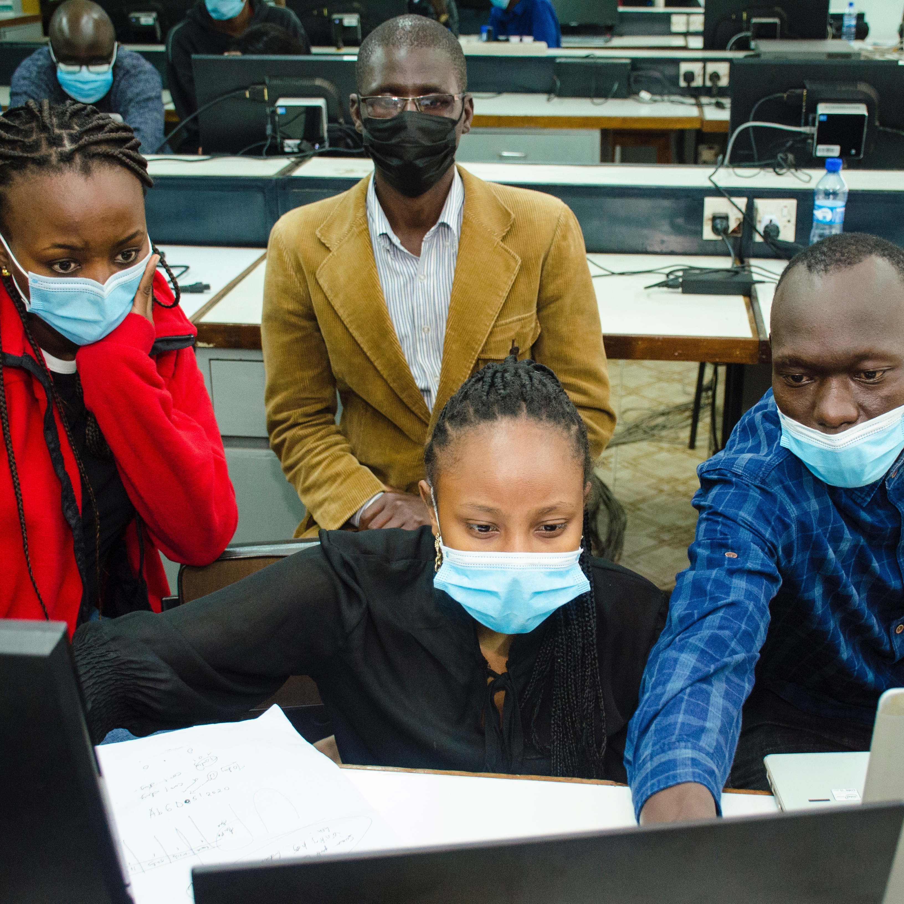
ATTITUDE TOWARDS COVID-19 IN AFRICA
TwEEt VADER GROUP:
Langa Moses
Yvonne Makena
Dennis Kiyeng
Diana Mutheu

Slide 3
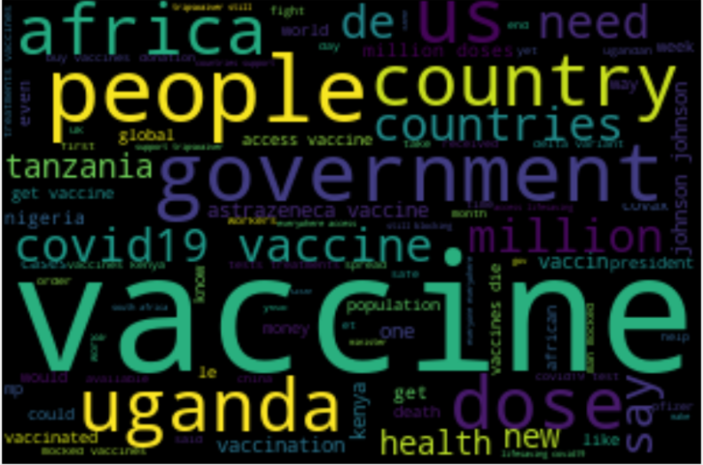
DATA ACQUISITION AND CLEANING
Our word cloud displaying major words in the tweets after cleaning.

Slide 4
Objectives
To get the attitude towards COVID-19 vaccines using machine learning techniques
To measure polarity and subjectivity of the tweets towards Covid-19 Vaccines
To measure attitude towards COVID-19 vaccines in majorly tweeted African Countries

Slide 5
DATA ACQUISITION AND CLEANING
Our study area is Africa. We picked our coordinates longitude 5.511081 latitude22.603204 and a radius of 1800km. We passed in our search words as "coronavirus OR corona OR vaccination OR dose OR covid OR sputnik OR pandemic OR covid19 OR covid19 vaccines OR coronavirusvaccines OR astrazenecacovidvaccine OR johnson&johnson’sVaccine OR pfizervaccine" and we were able to scrap about 2000 tweets. This was inclusive of all languages spoken in Africa.
During data cleaning, we created a method to remove hyperlinks, special characters, emojis and @mentions from the tweets. We also removed stop words from various languages and added our own 'coronavirus','covid','pandemic','covid19','lockdown','amp','via','virus' and were left with 1127 tweets.

Slide 6
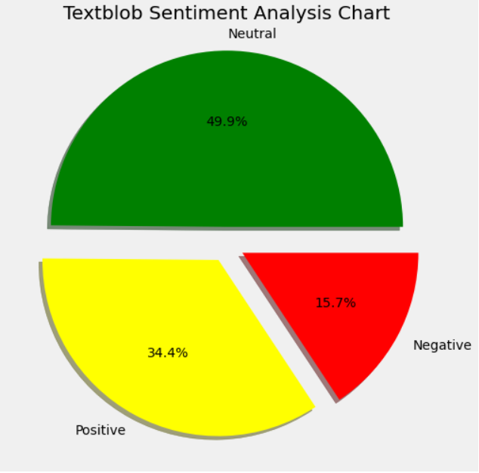
SENTIMENT ANALYSIS
Text blob Sentiment Analysis
More Neutral Tweets showing lack of proper functionality of Text Blob

Slide 7
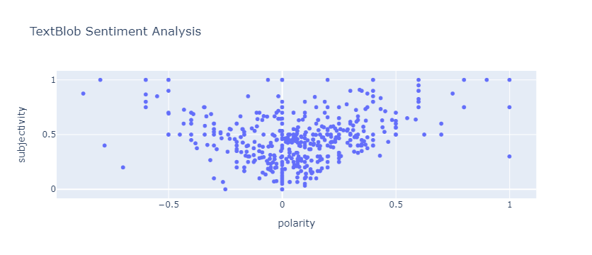
SENTIMENT ANALYSIS
Text Blob Scatter
More opinions to factual tweets.

Slide 8
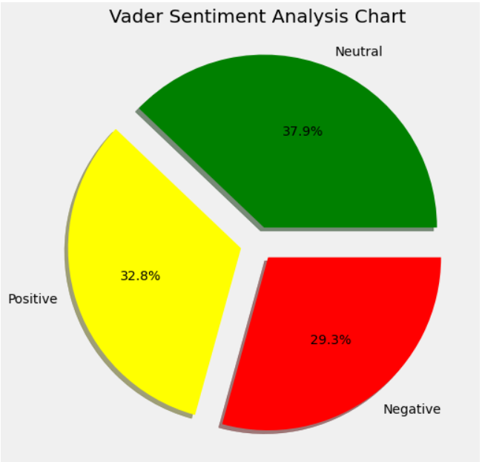
SENTIMENT ANALYSIS
Vader Sentiment Analysis
Performed better than Text Blob in Sentiment Analysis

Slide 9
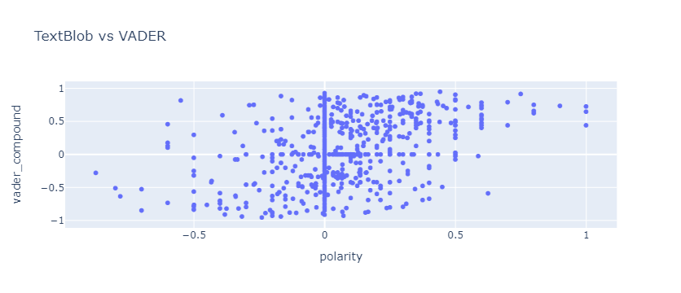
SENTIMENT ANALYSIS

Slide 10
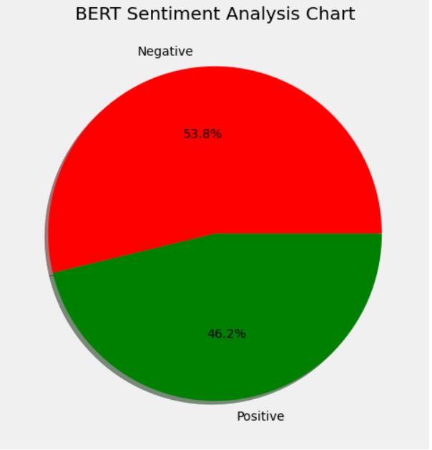
SENTIMENT ANALYSIS
BERT Sentiment Analysis
Most tweets were negative

Slide 11
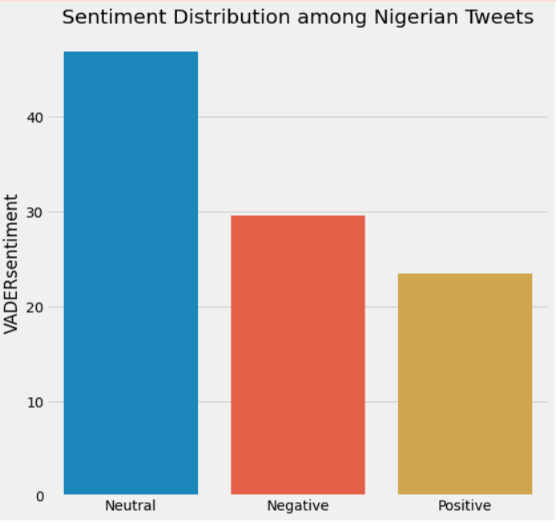
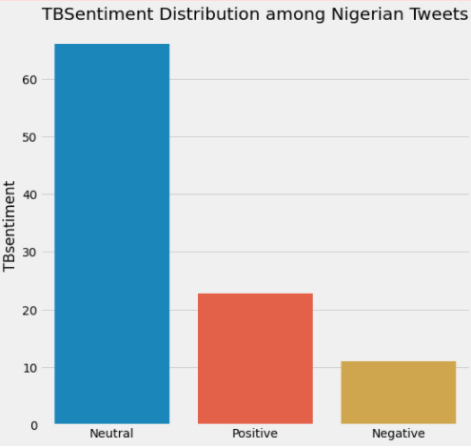
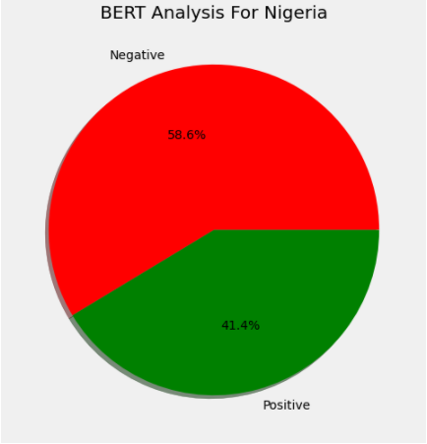
PER COUNTRY SENTIMENT ANALYSIS
Nigerian

Slide 12
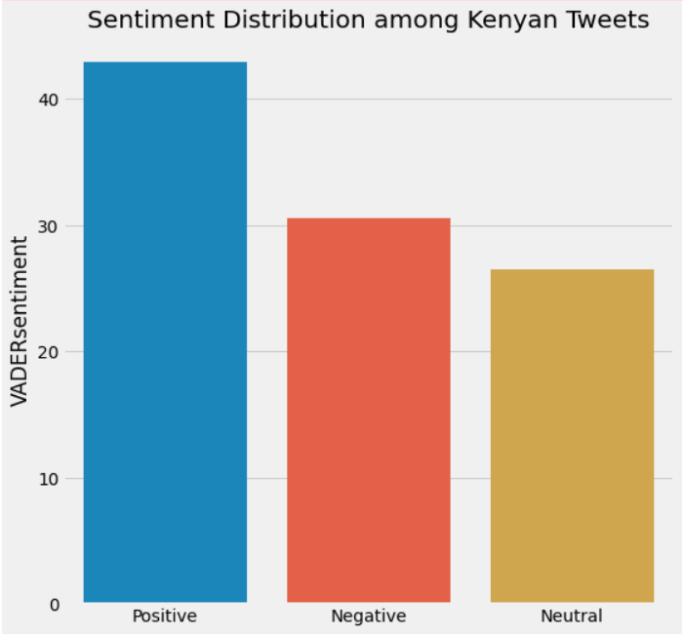
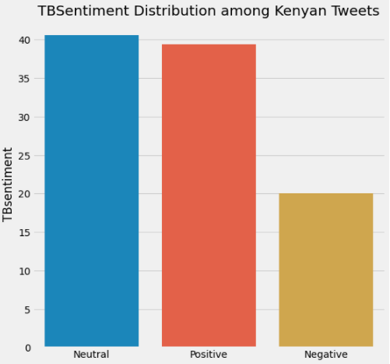
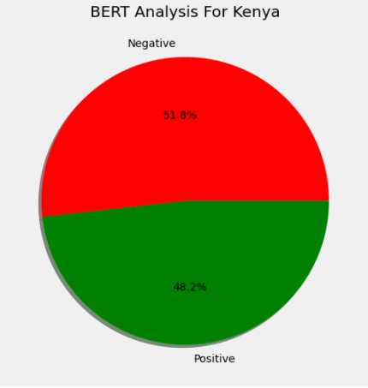
PER COUNTRY SENTIMENT ANALYSIS
Kenya

Slide 13
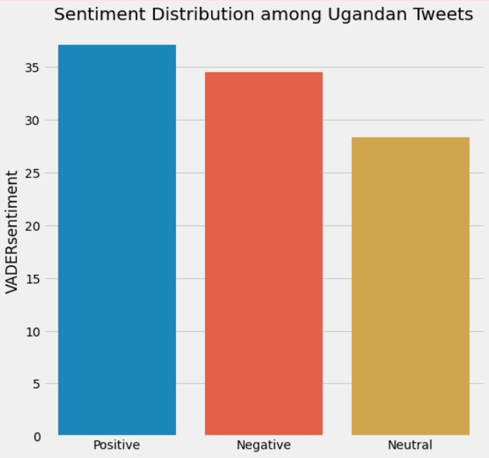
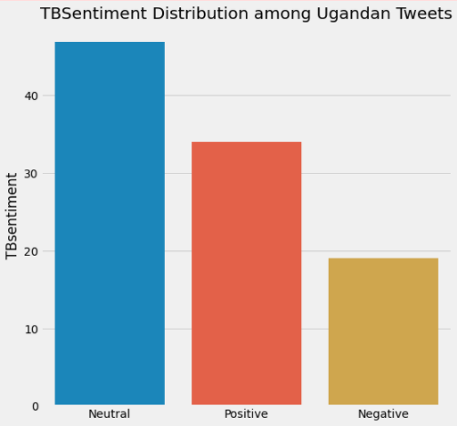
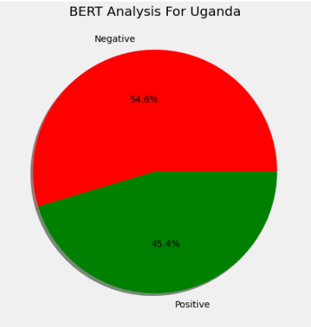
PER COUNTRY SENTIMENT ANALYSIS
Uganda

Slide 14
CONCLUSION
BERT model performed better than the Sentiment Analysis Tools.(Text Blob and Vader)

Slide 15
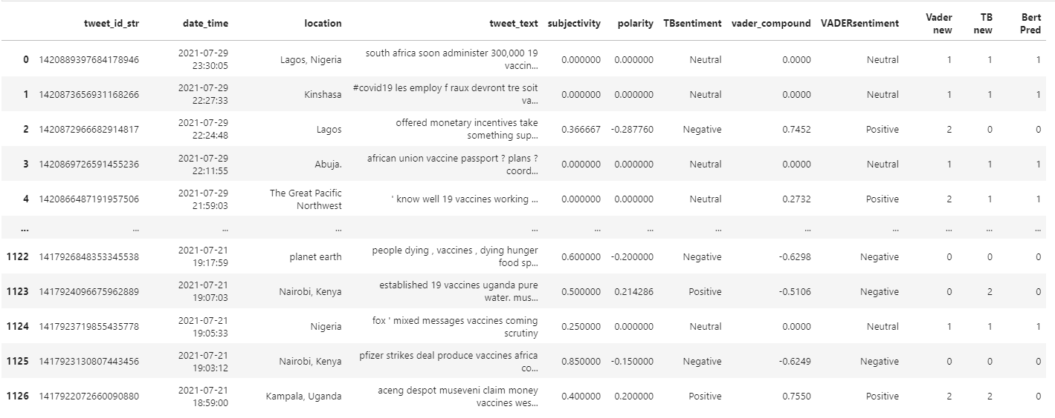
CONCLUSION

Slide 16
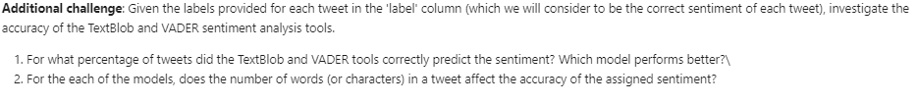
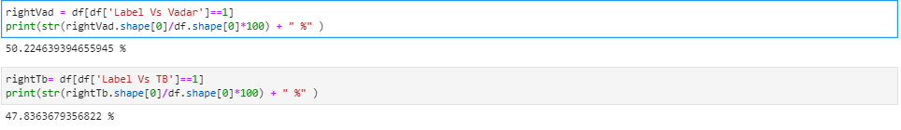
Nikita’s Challenge.

